Slide 1
An Introduction to Hierarchical Modeling

Slide 2
Introduction
Linear models are used to describe how a variable of interest (outcome) depends on other variables (effects)
Effects can be fixed or random
Determining values of fixed effects from the data is known as “estimation” while determining values of random effects is called “prediction”
The basic unit of analysis (subject) is called a level 1 unit; the next highest (group) is level 2
The notation “y_{ij}” will mean the outcome of patient i of group j

Slide 3
Fixed and Random Effects
Fixed effects
  the values that occur in the data are all values about which inference is to be made, i.e. age, sex ….
Random effects
  A variable enters the equation as a random effect if it is considered a random selection from a larger population, i.e. days (interest is in drawing inferences that are valid for the complete population of levels) hospitals, doctors (levels represent only a random sample of a larger set of potential levels) ….

Slide 4
Mixed Model
Fixed effects enter the model equation only through the mean
Random effects enter the model equation only through the variance
The mixed model equation can be regarded as a method of dealing with a complicated set of variances and covariances which we know affect the data

Slide 5
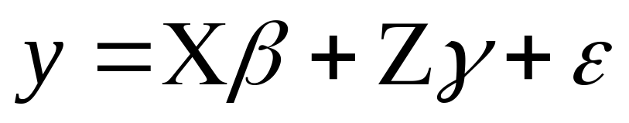
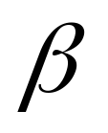
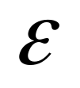
Linear Mixed Models for Longitudinal Data
represents
  factors that affect subject-specific regression coefficients.
  parameters that are assumed to be the same for all subjects
γ represents
  parameters that are allowed to vary over subjects
  subject-specific regression coefficients that reflect the natural heterogeneity in the population.
represents
  represents within-subject variation
  has a covariance matrix that is block diagonal with each block corresponding to a subject.

Slide 6
Estimation in Mixed Models
Variance-covariance matrix of the observations involves
  the covariance structure of the random effects, denoted
  as G (i.e. var (γ) = G)
  the covariance structure of the random errors, denoted
  as R (i.e. var (y|γ) = R )
  y ~ N(Xβ, ZGZ^{T} + R)
Ordinary least squares (OLS) vs Generalized least squares (GLS)
  GLS: estimate of G and R

Slide 7
Estimation in General Linear Models versus Mixed Models
Estimates parameters and standard errors using OLS
Assumes errors are independent and identically distributed (iid), and with common variance
GLM
Estimates parameters and standard errors using OLS
Estimates G and R using a likelihood-based method
Mixed Model

Slide 8
Random Effects
the errors are not iid
Sources of Error
  Random Effects
    reflect how much subject-specific profiles deviate from the average profile.
  Serial Correlation
    usually is a decreasing function of the time separation between measurements.
  Measurement Error
    for some measurements, there may be a certain level of variation in the measurement process itself.

Slide 9
Importance of Covariance Structures
Covariance structures
  model all the variability in the data, which cannot be explained by the fixed effects
  represent the background variability that the fixed effects are tested against
  must be carefully selected to obtain valid inferences for the parameters of the fixed effects.

Slide 10
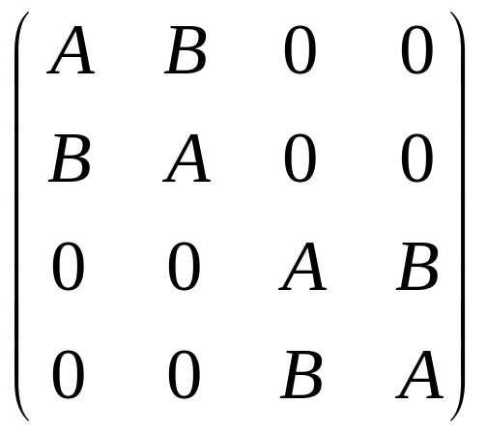
Covariance Marix
Compound symmetric structure
Two levels of variation, σ_{u} (group level variation) and σ_{e} (remaining variation)
If there were two groups each with two subjects, the covariance matrix V would be
A = σ_{u}² + σ_{e}²
B = σ_{u}²

Slide 11
Variance Components
σ_{u}² is the amount of variation due to the difference among groups
σ_{e}² is the remaining subject variation
σ_{u}² + σ_{e}² is the total variation among subjects
ρ = σ_{u}²/(σ_{u}² + σ_{e}²) is the proportion of total variation due to differences among groups (intraclass correlation)

Slide 12
Conceptual Computation Sequence
Recall y ~ N(Xβ, ZDZ^{T} + R).
Let V= var(Y) = ZDZ^{T} + R.
Solve β = (X^{T}V^{–1}X)⁻¹X^{T}V⁻¹y to get best linear unbiased estimator (BLUEs) of fixed effects.
  This is the same in OLS regression except that V enters the equation.
Notes:
In the OLS equation the V drops out because it is diagonal.

Slide 13
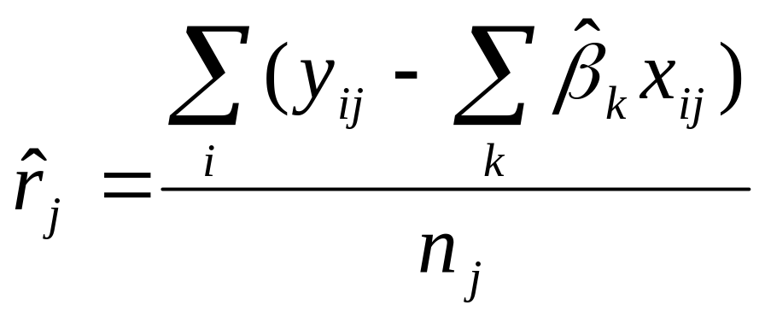
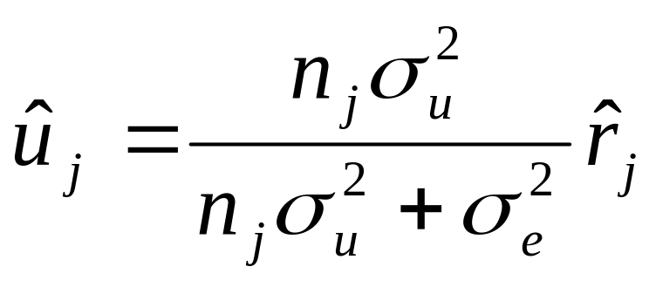
Computation (continued)
2. Calculate level 2 residuals
3. Calculate predicted group effects

Slide 14





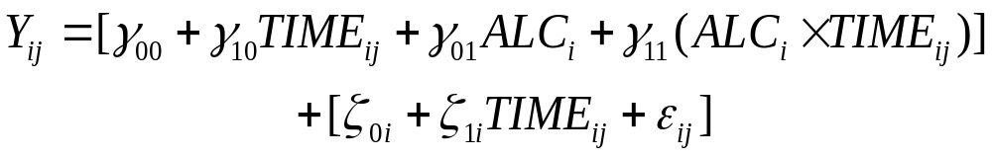
Random Coefficients Model – complete model
The composite specification shows how the outcome depends simultaneously on:
  the level-1 predictor TIME and the level-2 predictor ALC as well as
  the cross-level interaction, ALC∗TIME. This tells us that the effect of one predictor (TIME) differs by the levels of another predictor (ALC)
The composite specification also:
  Demonstrates the complexity of the composite residual—this is not regular OLS regression
  Is the specification used by most software packages for multilevel modeling
  Is the specification that maps most easily onto the person-period data set…

Slide 15


Random Coefficients Model – level 2 for between-subject differences in change
For the level-1 intercept (initial status)
Population average true initial status for controls.
Difference in population average true initial status between controls and alcoholics.
For the level-1 slope (rate of change)
Population average annual rate of true change for controls.
Difference in population average annual rate of true change between controls and alcoholics.
Key to remembering subscripts on the gammas (the γ’s)
First subscript indicates role in level-1 model (0 for intercept; 1 for slope)
Second subscript indicates role in level-2 model (0 for intercept; 1 for slope)
The level-2 model must capture both the averages and the variation about these averages
And…it must allow for systematic interindividual differences in change according to variation in predictor(s) (here, GROUP )

Slide 16


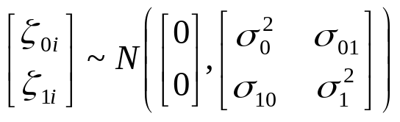
Stochastic Components of the level 2
General idea:
Model postulate the existence of an average population trajectory for each group
Because of the level-2 residuals, each subject i has his own true change trajectory (defined by π_{0i} and π_{1i})
Assumptions about the level-2 residuals:
Population residual variance of true initial status, controlling for group.
initial status
Population residual variance of true rate of change, controlling for group.
rate of change
Population residual covariance between true initial status and true rate of change, controlling for group.

Slide 17



Unconditional Model – partition variation between and within persons
Level-1 Model:
Level-2 Model:
Composite Model:
Within-person deviations
Grand mean across individuals and occasions
Person-specific means
Parameter
Model A
Within-person variance
Fixed Effects
Initial Status, π_{0i}
Intercept
γ₀₀
25.61
(<0.001)
Between-person variance
Variance Components
Level 1
Within-Subject
In Initital Status
28.71
(<0.001)
σ_{ε}²
7.23
(<0.001)
Level 2
σ₀²

Slide 18


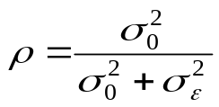
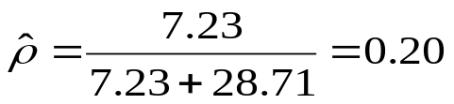
Intraclass Correlation Coefficient Estimation
Major purpose of the unconditional means model:
  To partition the variation in Y into two components
Quantifies the amount of variation between individuals regardless of time
Estimated between-person variance
Estimated within-person variance
Quantifies the amount of variation within individuals over time
Intraclass correlation compares the relative magnitude of these VCs by estimating the proportion of total variation in Y that lies “between” people
An estimated 20% of the total variation in NAA is attributable to differences between people
But what role does TIME play?

Slide 19

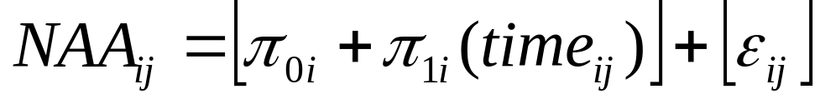




Unconditional Model – change over time Level-1
Structural portion,which embodies our hypothesis about the shape of each person’s true trajectory of change over time
Stochastic portion,which allows for the effects of random error from the measurement of person i on group j.
Key assumption: In the population, NAA_{ij} is a linear function of time since last drink on alcoholics group j
i indexes persons (i=1 to n )
j indexes groups (j=1 to 3)
ε_{i1}, ε_{i2}, and ε_{i3} are deviations of i’s true change trajectory from linearity on each group (measurement error)
Individual i’s hypothesized true change trajectory
40
NAA
•
  π_{0i} is the intercept of i’s true change trajectory, his true value of NAA at time point 1, his “true initial status”
35
π_{1i} is the slope of i’s true change trajectory, his yearly rate of change in true NAA, his true “annual rate of change”
30
•
•
1 year
25
20
1
2
3
TIME POINT

Slide 20
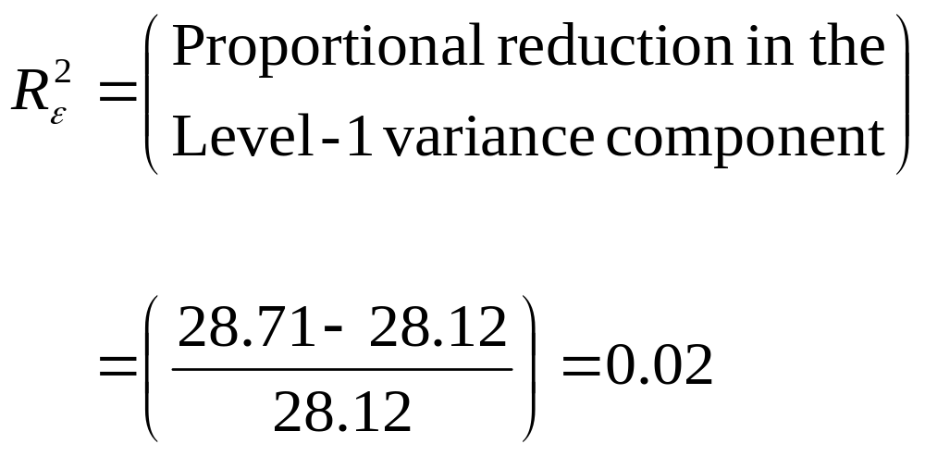
Random Coefficients Model
40% of the within-person variation in ALCUSE is associated with linear time
Only 2% of the within-person variation in NAA is associated with linear time

Slide 21
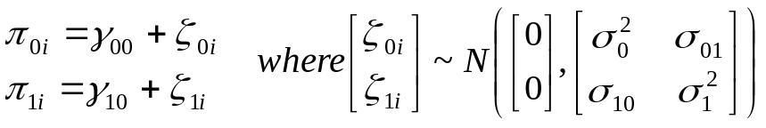
Random Coefficients Model – changes in time
Level-1 Model:
Level-2 Model:
Composite residual
Composite Model:
variance components
Parameter
Model B
Variance Components
Average true initial status at time point 1
Average true rate of change
Level 1
Within-Subject
In Initital Status
σ_{ε}²
28.12
(<0.001)
Model-
Parameter
Model B
σ₀²
8.14
(<0.001)
Fixed Effects
Initial Status, π_{0i}
Level 2
In Initital Status
In rate of change Covariance
σ₁²
0.0003
(0.07)
γ₀₀
Intercept
25.41
(<0.001)
σ₀₁
-0.021
(0.04)
Rate of change, π_{1i}
γ₁₀
0.0061
(0.07)
Intercept
Level-2 (between-persons):
There is between-person residual variance in initial status (but careful, because initial status has changed)
There is no significant between-person residual variance in rate of change
Estimated res. covariance between initial status and change is n.s.
Level-1 (within person)
There is still unexplained within-person residual variance

Slide 22
Inference
To test for the need for random effects, run proc Mixed twice, with and without random effects
Subtract the values of –2 log likelihood and compare to a chi-squared table with DOF = number of variance components – 1 (1 in this case)
The p-values on the estimated variance components cannot be used to test for the need for random effects

Slide 23
Advantages and Disadvantages of Hierarchical Models
Advantages
  Correct modeling of variation
  If ordinary least squares model is used when there is hierarchical structure, estimated standard errors will be too small
  BLUPs are valid even when providers have a small number of patients
Disadvantages
  Difficult to explain results to non-statisticians

